Slide 1



Smart Sort: AI-Powered Garbage Classification System

Slide 2

Learning Objectives
Understand the real-world application of AI/ML in
environmental tech
Learn image classification using Convolutional Neural
Networks (CNNs)
Integrate dataset preprocessing, model training, and
evaluation
Apply Python-based tools for end-to-end AI project lifecycle
Develop a deployable prototype for smart waste management
GOAL
Source :
www.freepik.com/

Slide 3



Tools and Technology used
Programming Language: Python
ML Framework: TensorFlow / Keras / PyTorch
Image Processing: OpenCV
Development Environment: Jupyter Notebook / Google Colab
Libraries: NumPy, Pandas, Scikit-learn, Matplotlib
Dataset: TrashNet / Custom Garbage Dataset (Plastic, Paper, Metal, Organic)
(Optional Deployment): Flask for Web App Interface

Slide 4
Methodology
Step-by-Step Workflow:
Dataset Collection & Labeling
Data Preprocessing
Resize, normalize images
Data augmentation
Model Building
CNN with multiple layers
4. Training & Validation
Split dataset (80:20)
Evaluate accuracy/loss
5. Model Testing
Confusion matrix, performance metrics
6. Output Generation
Predict class of real-time garbage image

Slide 5

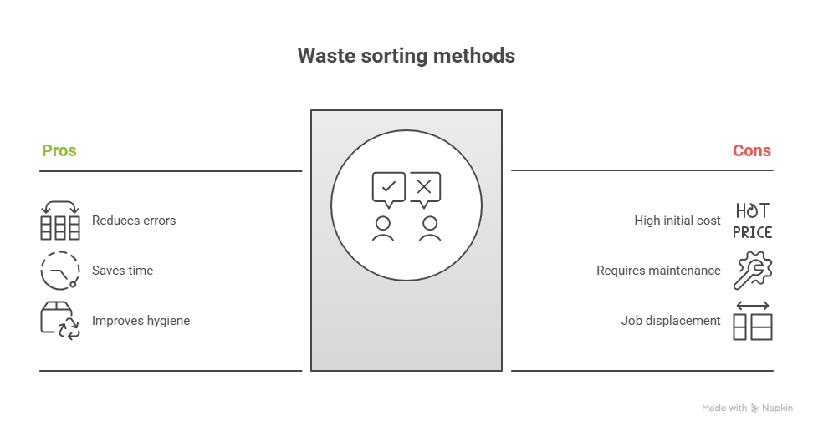
Problem Statement:
Waste management is a critical urban issue
Improper segregation leads to recycling challenges
Manual sorting is time-consuming, inaccurate, and unhygienic
Need for an automated, intelligent classification system

Slide 6
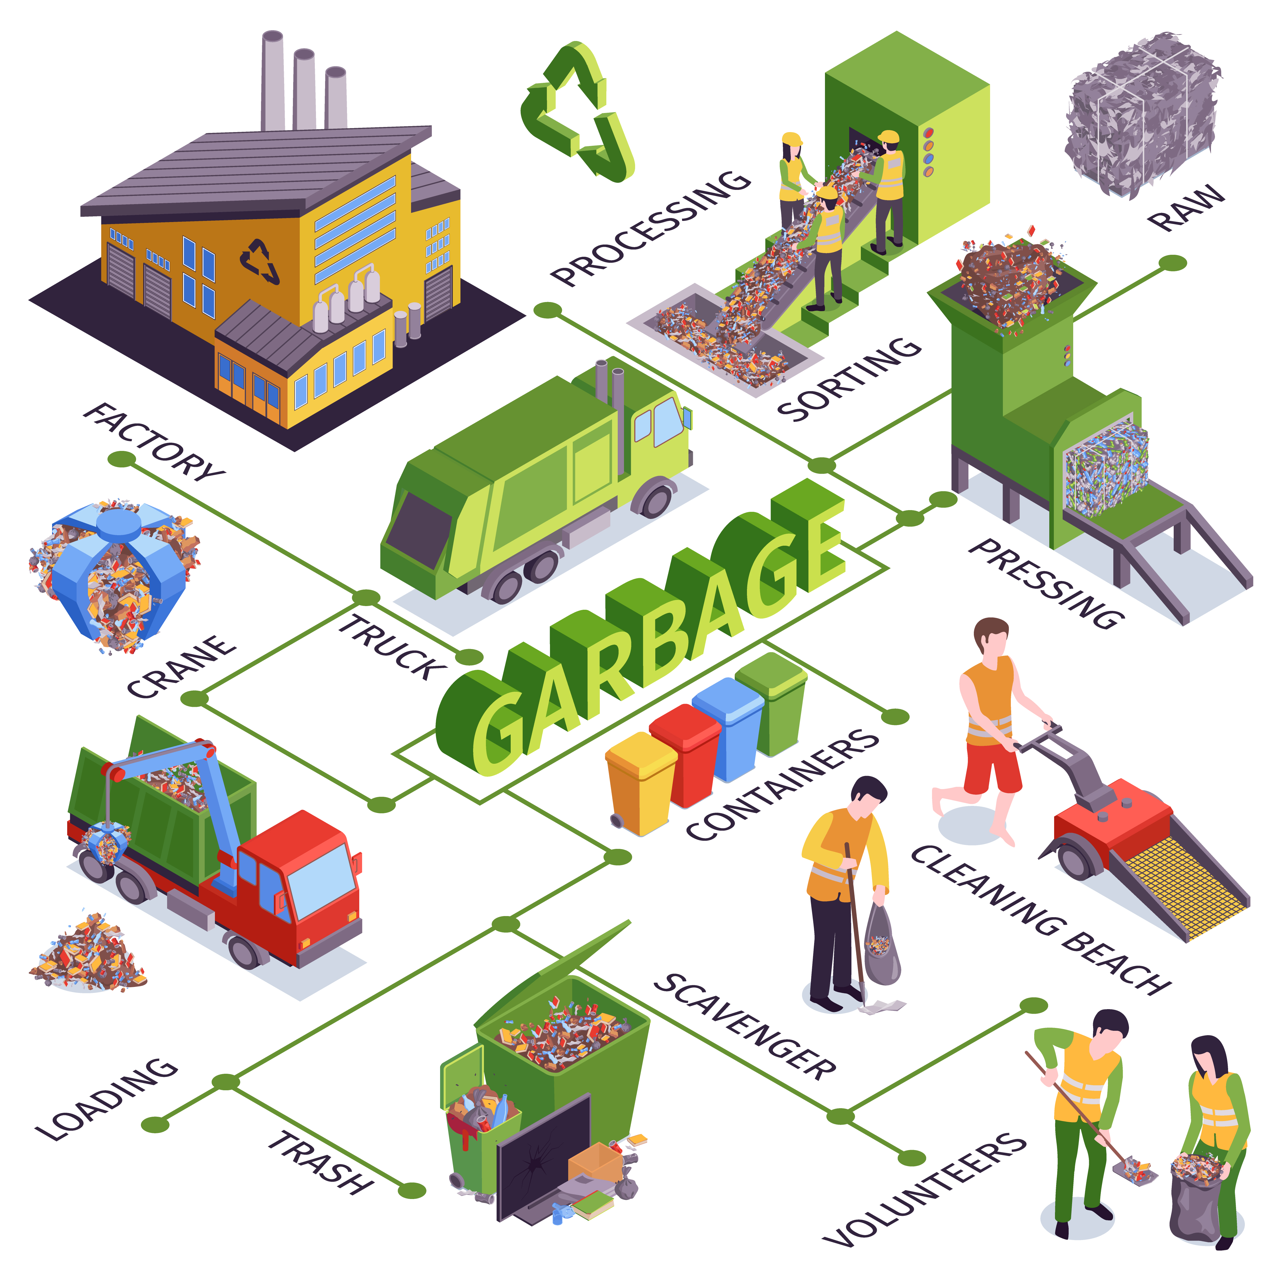
Solution:
Develop a CNN-based image classification model
Automatically classify waste into:
🟢 Organic | 🔵 Plastic | 🟡 Metal | 🔴 Paper | ⚫ Others
Ensure the model is: Accurate (≥90% precision)
Scalable for smart bins
Easy to integrate into waste management systems
Potential for use in municipal AI bins, school recycling
programs, and industrial segregation

Slide 7
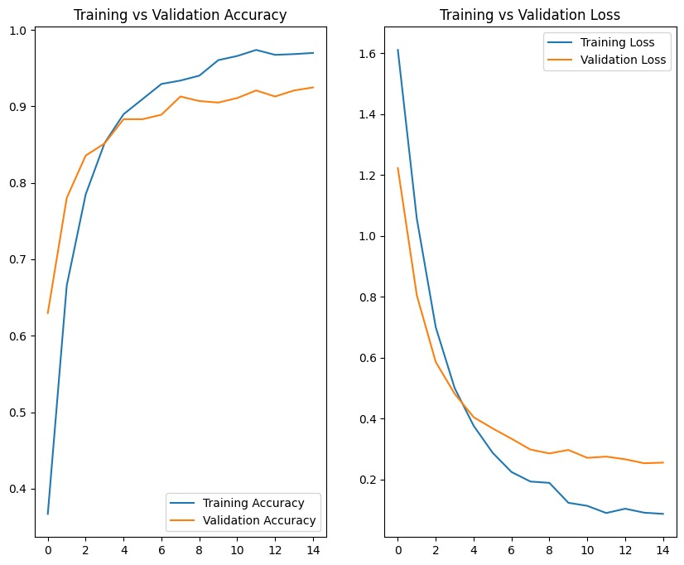
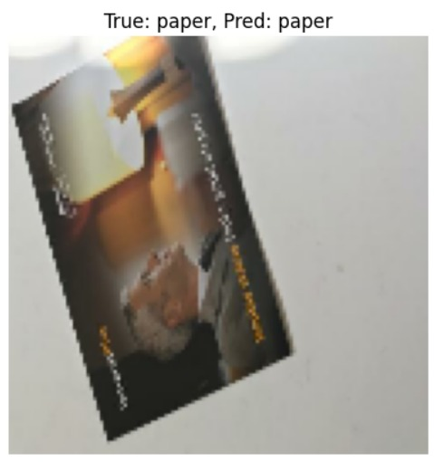
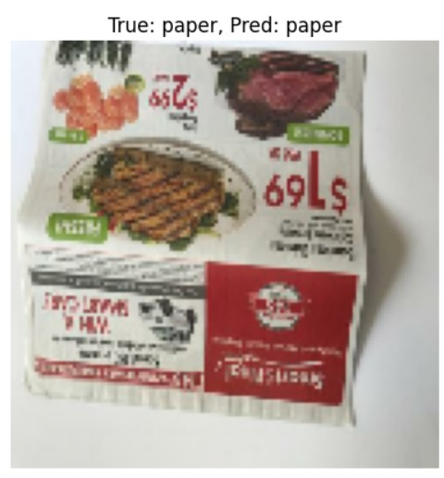
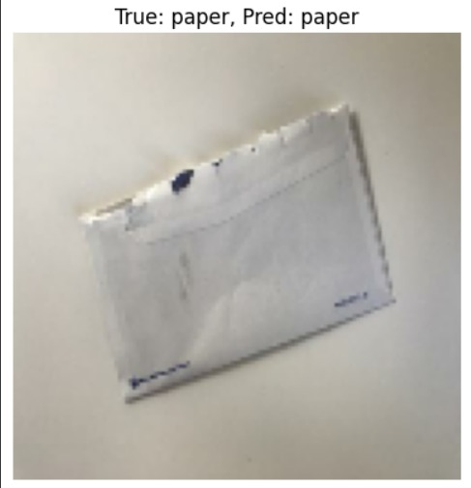
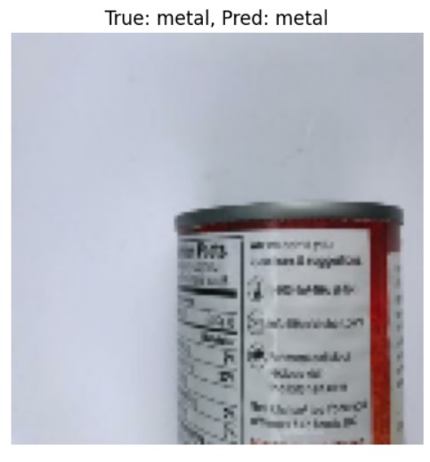
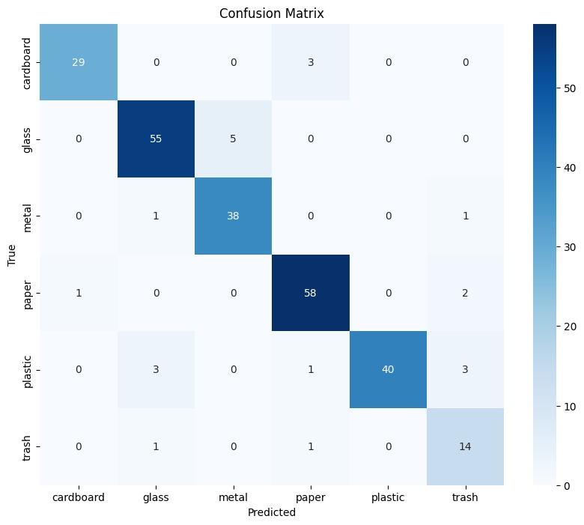
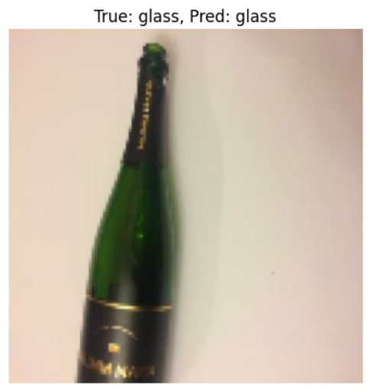
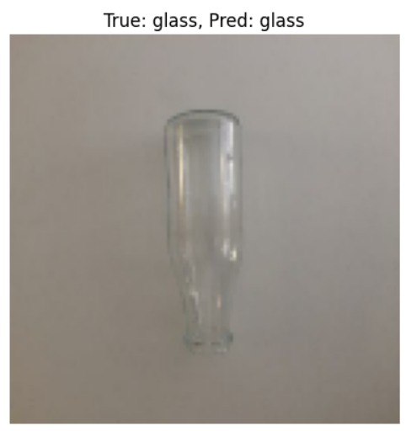
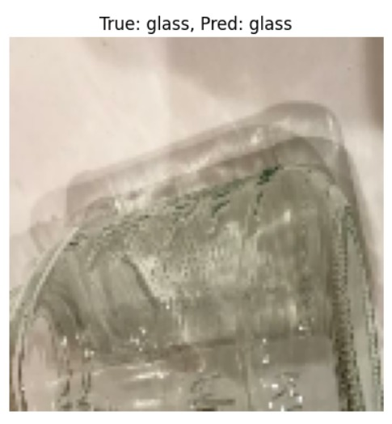
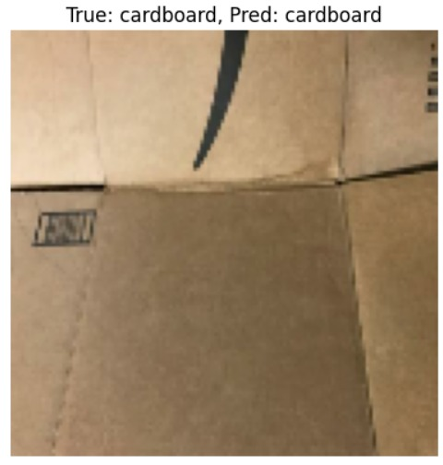
Screenshot of Output:

Slide 8

Conclusion:
Successfully built a functional AI/ML model for garbage classification
Can significantly aid in smart city waste segregation systems
Reduces manual effort, increases recycling efficiency
Future Scope:
Real-time camera-based recognition
Integration with IoT-enabled smart bins
Multi-language voice assistant for human interaction

